Slide 1

Java EE – Spring

Slide 2
Java EE – Spring
Spring framework
Inversion of Control
Dependency injection

Slide 3
Java EE – Spring
IoC
Hollywood Principle – „Don't call us, we'll call you”
Decouple implementation aspects
We don’t have to create a new windowing system to create a desktop program
We don’t have to create a new web server implementation when creating a dynamic website
Developer can focus on the task
Examples:
Windowing systems
Servlet
EJB
…

Slide 4
Java EE – Spring
Implementations of IoC
Lookup
Service Locator design pattern
Contextual lookup
Factory method design pattern
Dependency Injection
Constructor injection
Setter injection
Field injection
Interface injection

Slide 5
Java EE – Spring
Example
Check package com.epam.training.spring.bare and its 3 classes
BusinessLogic
NetworkResource
DatabaseResource
The task is to create an automatic test for all scenarios in the BusinessLogic class

Slide 6
Java EE – Spring
Solution
Extract interfaces from the classes
Avoid object instantiation
Add setter method in BusinesLogic implementation, use the interface type
Test business logic with mock dependencies
See test implementation com.epam.training.BusinessLogicTest in src/test/java
It solvesd the testability question, but how will the application work in production?
What will set the dependencies?

Slide 7
Java EE – Spring
Dependency injection in Spring
Spring application context
Java
classes, interfaces
Internal representation
Post processing
Metadata
xml, annotation, java
Instantiate objects
Fully configured system

Slide 8
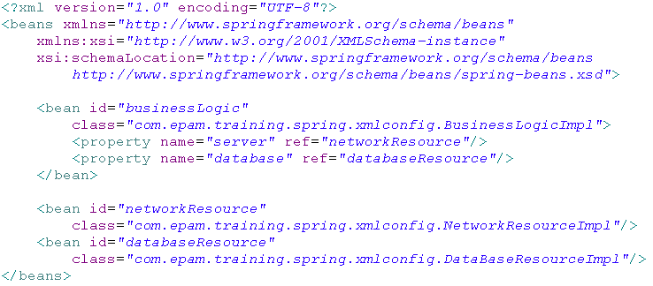
Java EE – Spring
Spring configuration

Slide 9
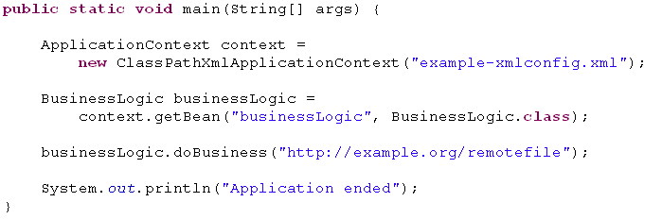
Java EE – Spring
Using spring in a standalone application

Slide 10
Java EE – Spring
Dependency injection types
Setter injection
<property name="propertyName" ref=„beanName"/>
p:propertyName="value"
p:propertyName-ref="beanName"
Constructor injection
<constructor-arg index="0" ref="something"/>
<constructor-arg index="1" ref="somethingElse"/>

Slide 11
Java EE – Spring
Spring bean attributes
Instantiation/destruction related attributes:
Init-method
Factory-method
Factory-bean
Destroy-method
Lazy-init
Scope (singleton, prototype)
Inheritence related attributes:
Abstract
Parent
Automatic dependency injection related attributes:
Autowire (byName, byType, constructor, no)
Autowire-candidate
Primary

Slide 12
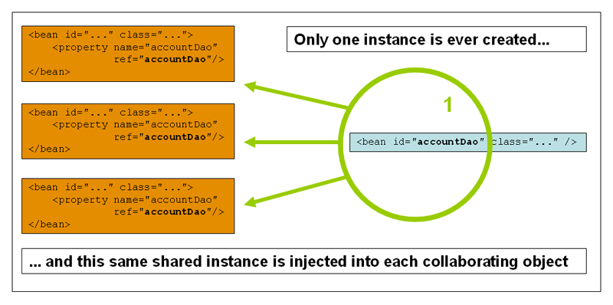
Java EE – Spring
Singleton scope

Slide 13
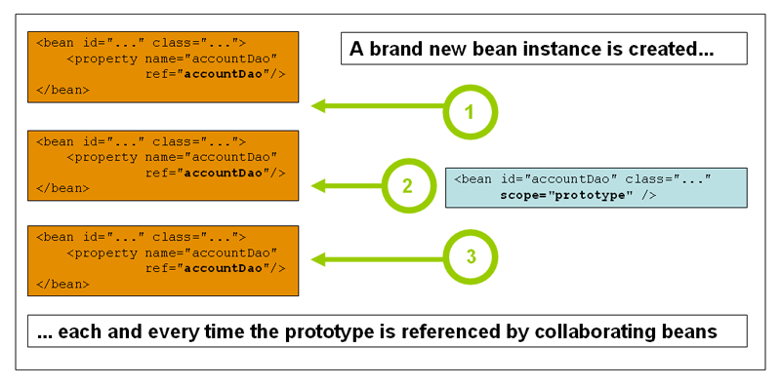
Java EE – Spring
Prototype scope

Slide 14
Java EE – Spring
Annotation based configuration
Enable annotations in XML
Use annotations on classes
@Component
@Repository
@Service
@Controller
Use annotations on attributes
@Autowired
@Required
@PostConstruct
@PreDestroy

Slide 15
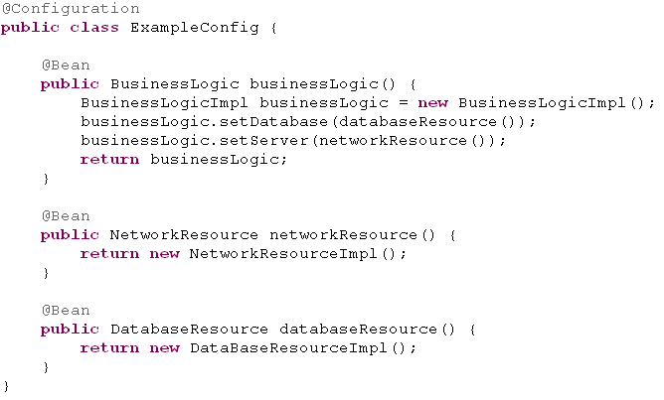
Java EE – Spring
Java based configuration

Slide 16
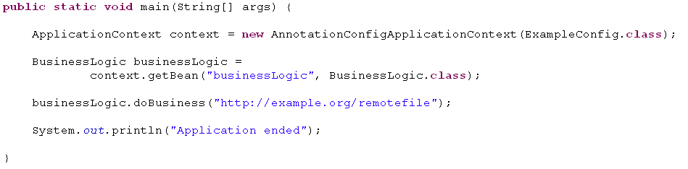
Java EE – Spring
Java based configuration

Slide 17
Java EE – Spring
Lifecycle of a bean
Initialization
Methods annotated with @PostConstruct
afterPropertiesSet() as defined by the InitializingBean callback interface
A custom configured init() method
Destroy
Methods annotated with @PreDestroy
destroy() as defined by the DisposableBean callback interface
A custom configured destroy() method

Slide 18
Java EE – Spring
Lifecycle of a Spring context
ApplicationListener
ContextRefreshedEvent
ContextStartedEvent
ContextStoppedEvent
ContextClosedEvent

Slide 19

Java EE – Spring
Junit 4.5+ and Spring
Configure JUnit to use Spring
Inject dependencies with @Autowire
Use Spring mock objects
JNDI
Servlet
Portlet

Slide 20

KÖSZÖNÖM A FIGYELMET!
Kis Bertalan
Bertalan_Kis@epam.com

